Slide 1
Generalized Group Lasso for Predictive Biomarker Identification
Wenxuan Deng
Working with Kevin Galinsky and Jacob Zhang

Slide 2
Outline
Background:
What is predictive biomarker?
Variable Selection with Lasso
Model:
Linear model
Group Lasso penalty term design
Simulations
Regularization parameter
Proportions of nonzero interactions
Signal/Noise ratio
Large-scale high dimensional data
Conclusions

Slide 3
Background

Slide 4
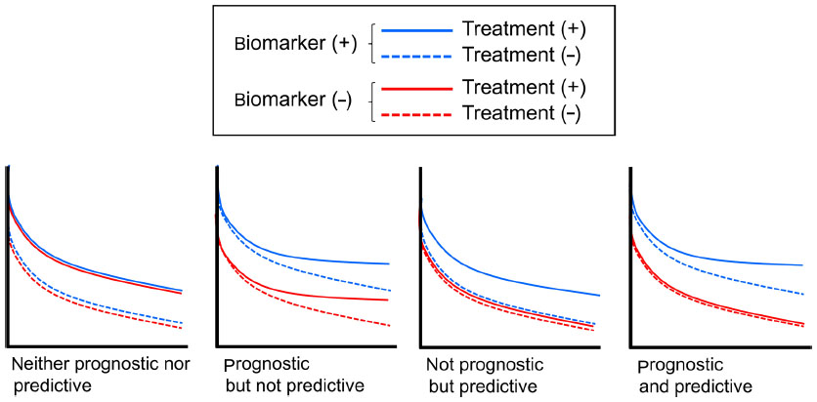
Prognostic Biomarkers and Predictive Biomarkers
Mukohara, Toru. Breast Cancer: Targets and Therapy 7 (2015)

Slide 5
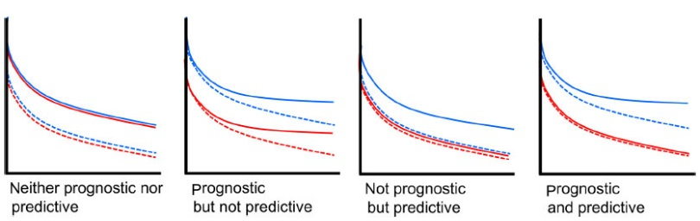

Slide 6
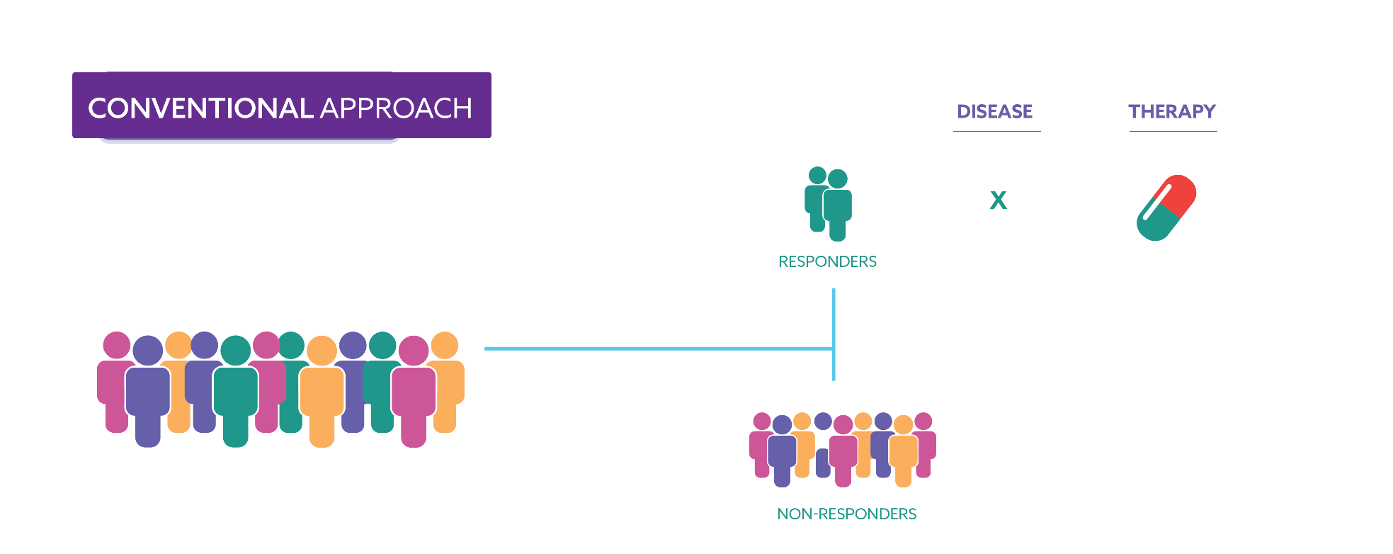
Patient Subgroup Identification
X
X

Slide 7
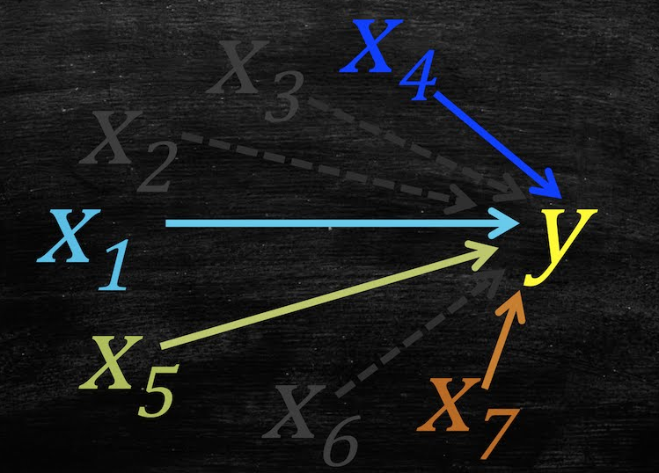
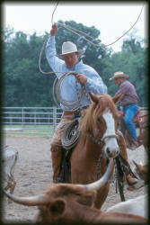
Variable Selection
Lasso

Slide 8
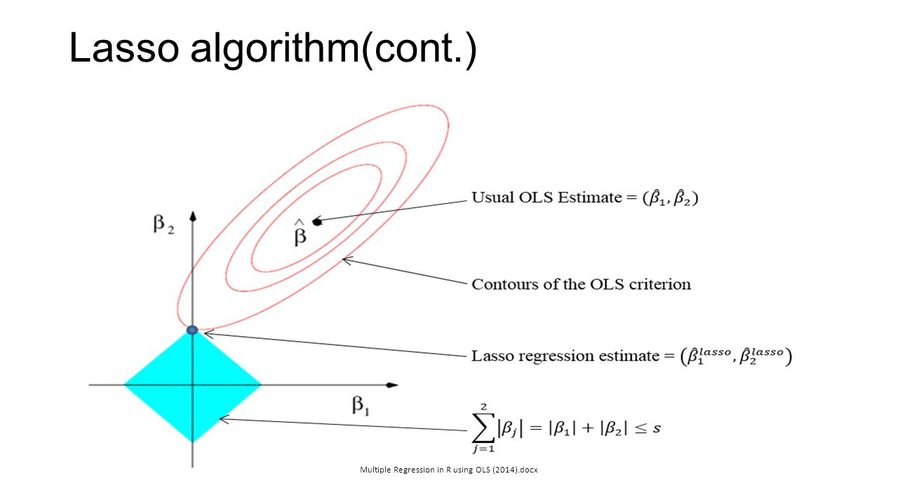

Lasso
$$\min_{β}\frac{1}{2}∥Y−Xβ∥^{2}+λ{\left|β\right|}_{1}$$
$$\min_{β}\frac{1}{2}∥Y−Xβ∥^{2}$$
$$s.t. {\left|β\right|}_{1}<λ$$

Slide 9
Model

Slide 10
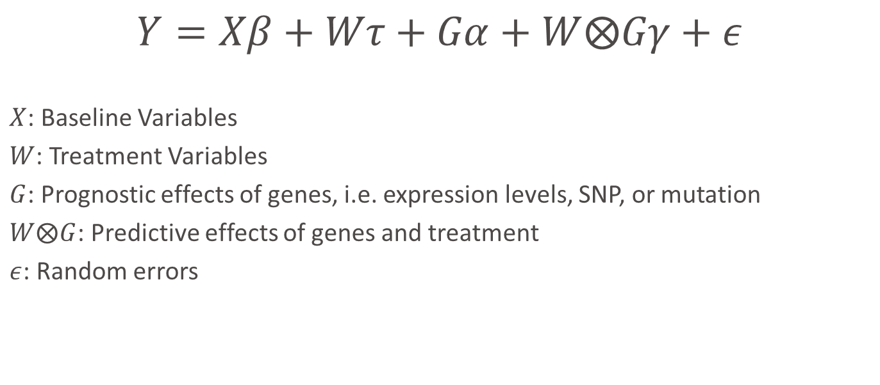
Model
$$Y=Xβ+Wτ+Gα+W⨂Gγ+ε$$
$X$: Baseline Variables
$W$: Treatment Variables
$G$: Prognostic effects of genes, i.e. expression levels, SNP, or mutation
$W⨂G$: Predictive effects of genes and treatment
$ε$: Random errors

Slide 11
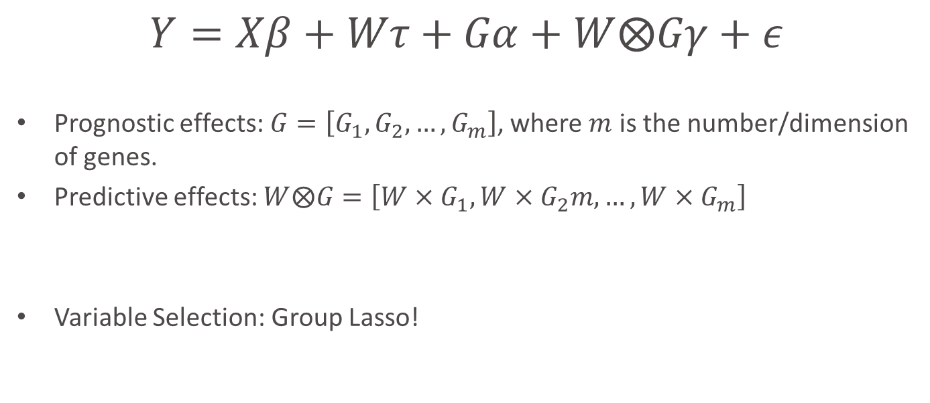
Model
$$Y=Xβ+Wτ+Gα+W⨂Gγ+ε$$
Prognostic effects: $G=\left[G_{1},G_{2},…, G_{m}\right]$, where $m$ is the number/dimension of genes.
Predictive effects: $W⨂G=\left[W×G_{1},W×G_{2}m,…,W×G_{m}\right]$
Variable Selection: Group Lasso!

Slide 12
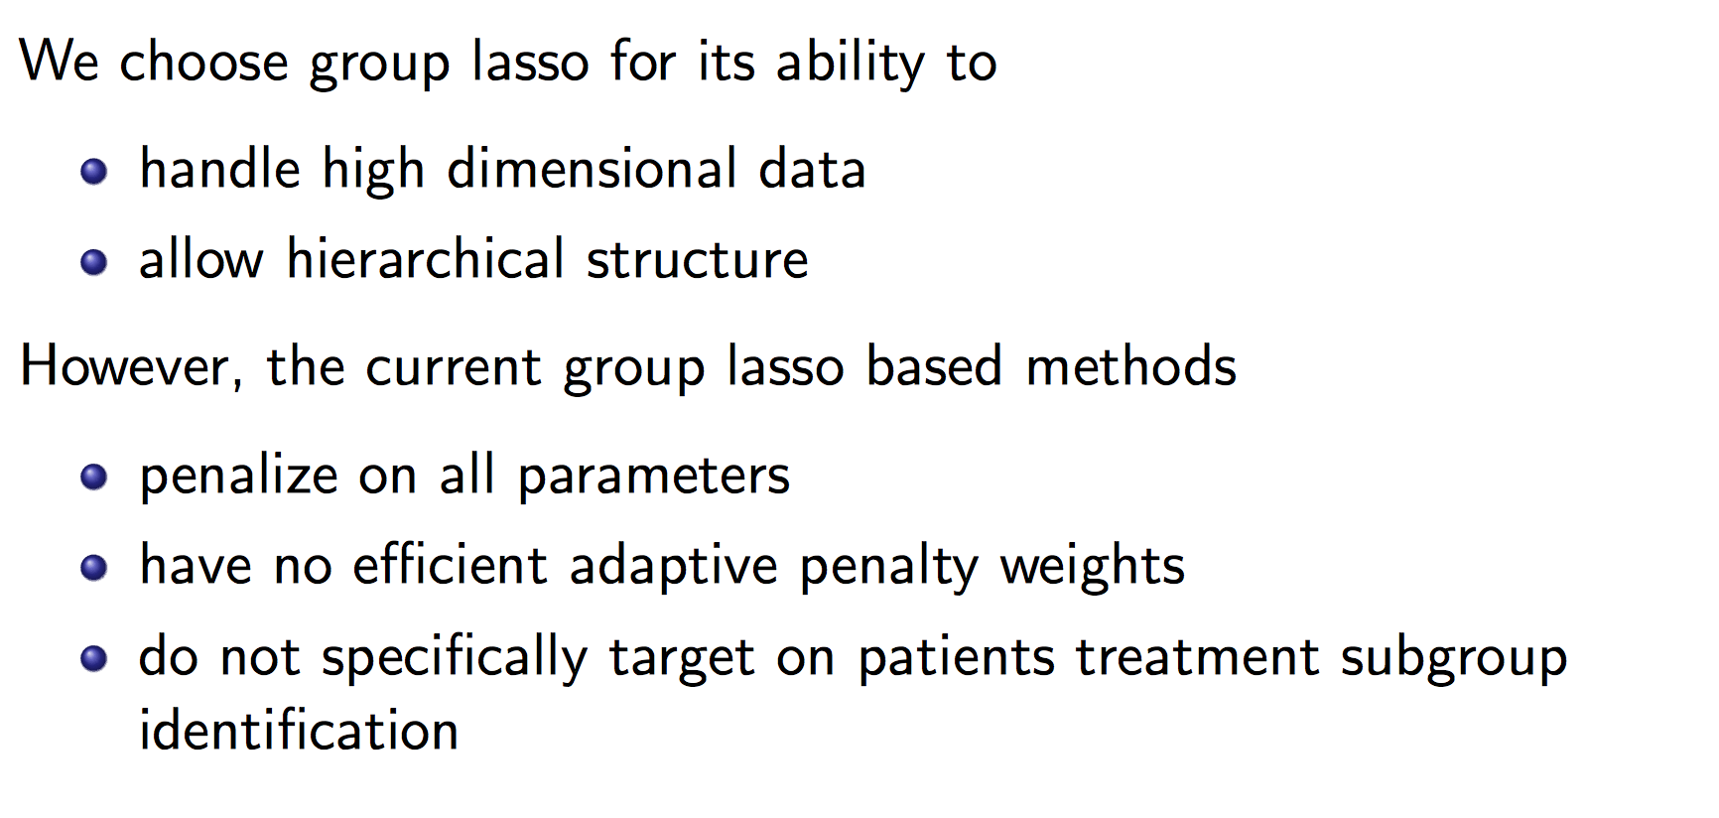
Group Lasso

Slide 13
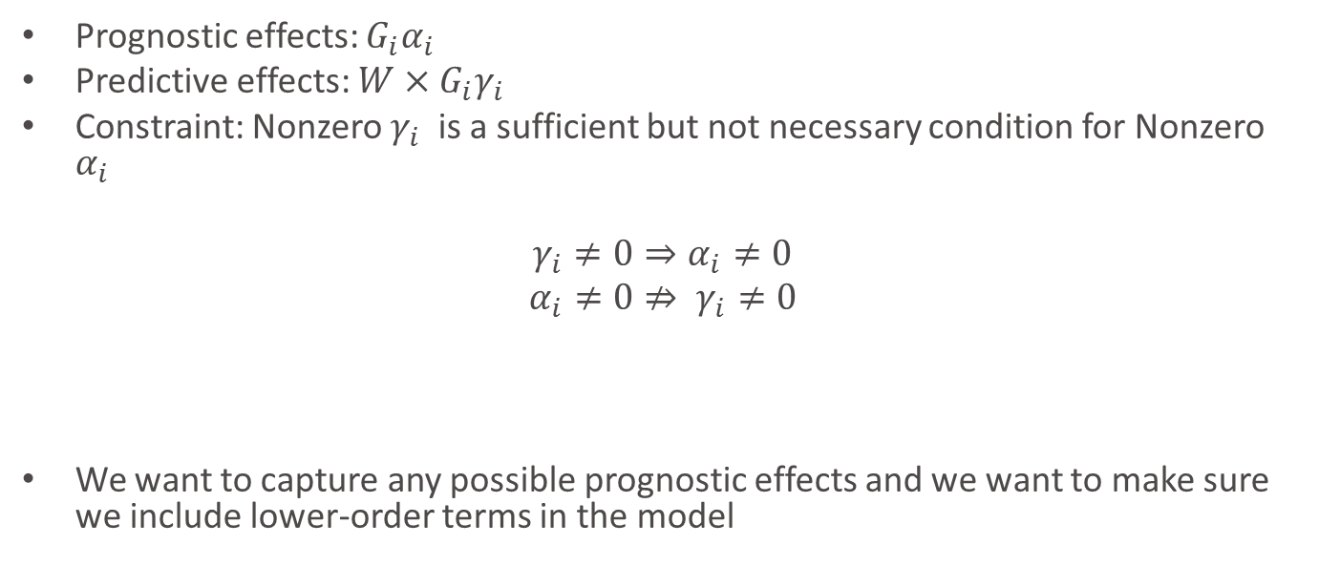
Constraint
Prognostic effects: $G_{i}α_{i}$
Predictive effects: $W×G_{i}γ_{i}$
Constraint: Nonzero $γ_{i}$is a sufficient but not necessary condition for Nonzero $α_{i}$
$γ_{i}≠0⇒α_{i}≠0$
$$α_{i}≠0⇏ γ_{i}≠0$$
We want to capture any possible prognostic effects and we want to make sure we include lower-order terms in the model

Slide 14
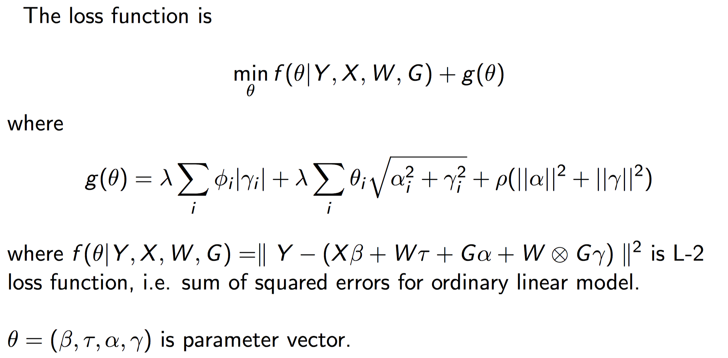
Loss Function
Group Lasso Structure
Elastic Net
Regularization
Parameter

Slide 15
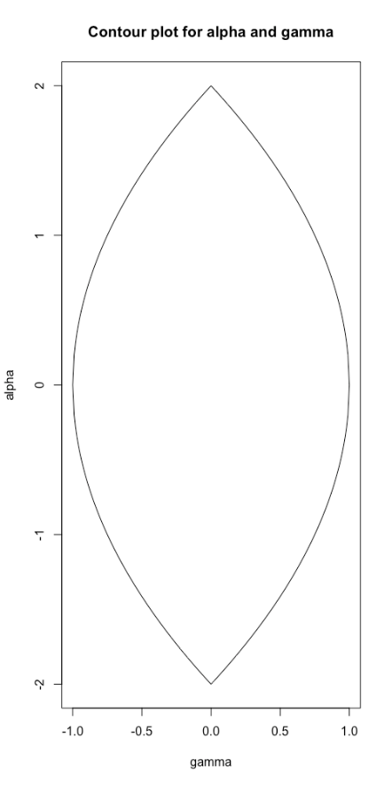




Geographical Interpretation of Group Lasso Structure
$$γ=0, α≠0$$
Convex function $f(α,γ)$
$$g\left(α,γ\right)=\left|γ\right|+\sqrt{α^{2}+γ^{2}}$$
$$γ≠0, α≠0$$

Slide 16
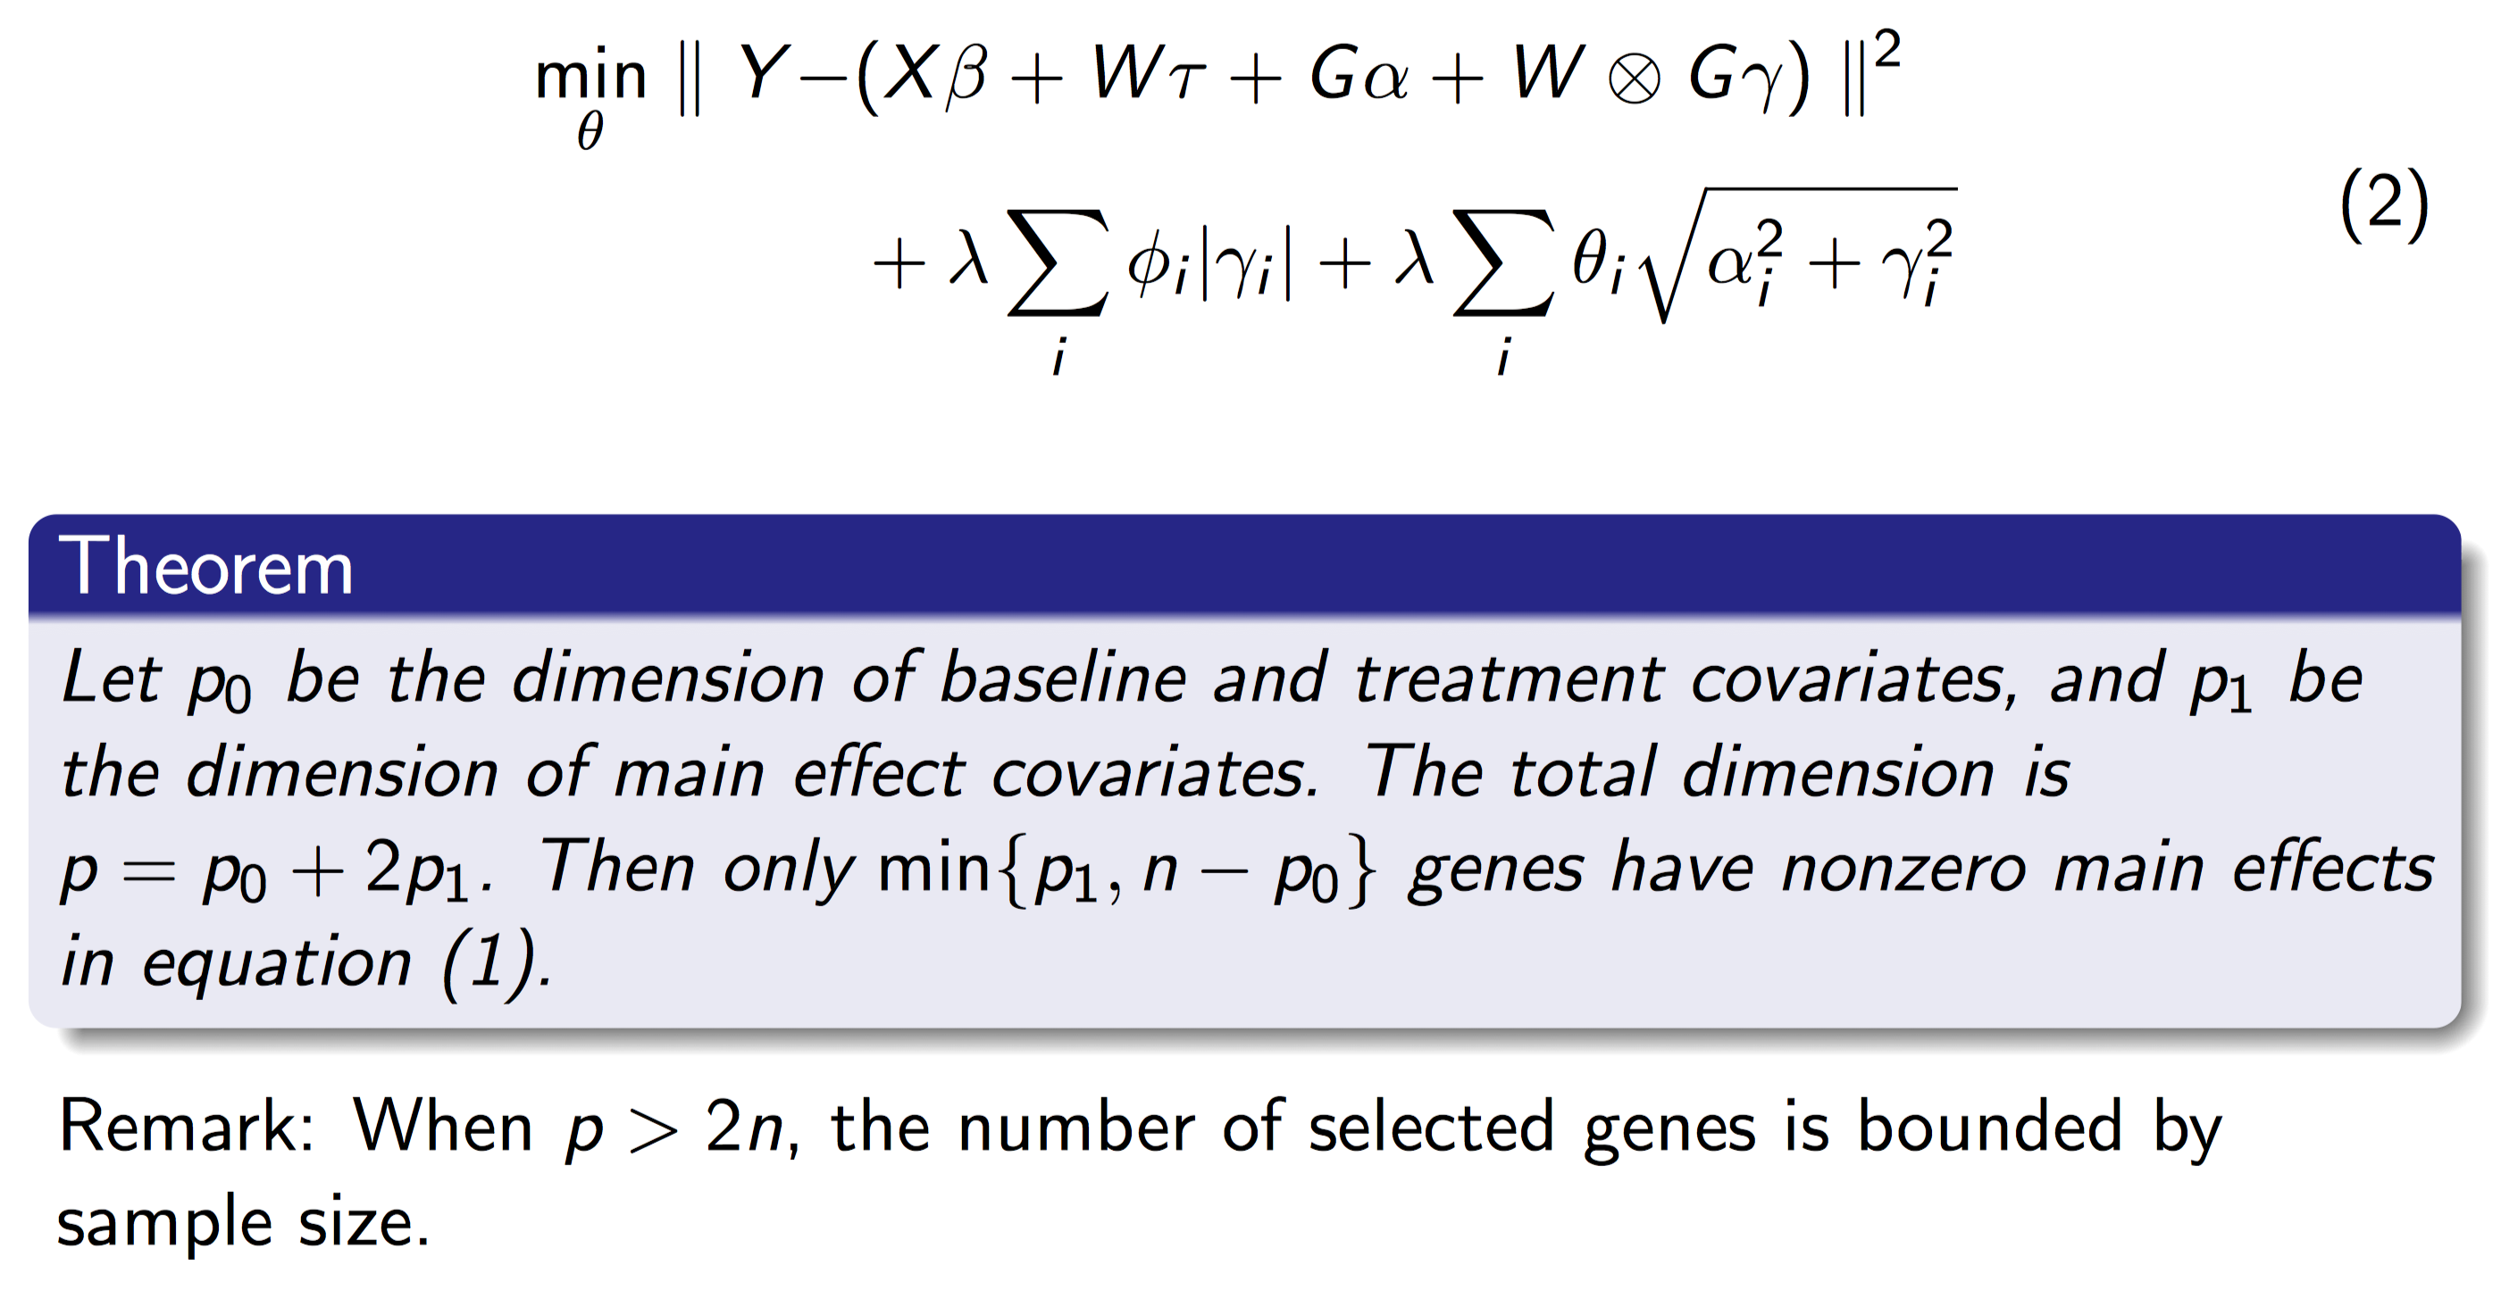
Elastic Net Structure

Slide 17
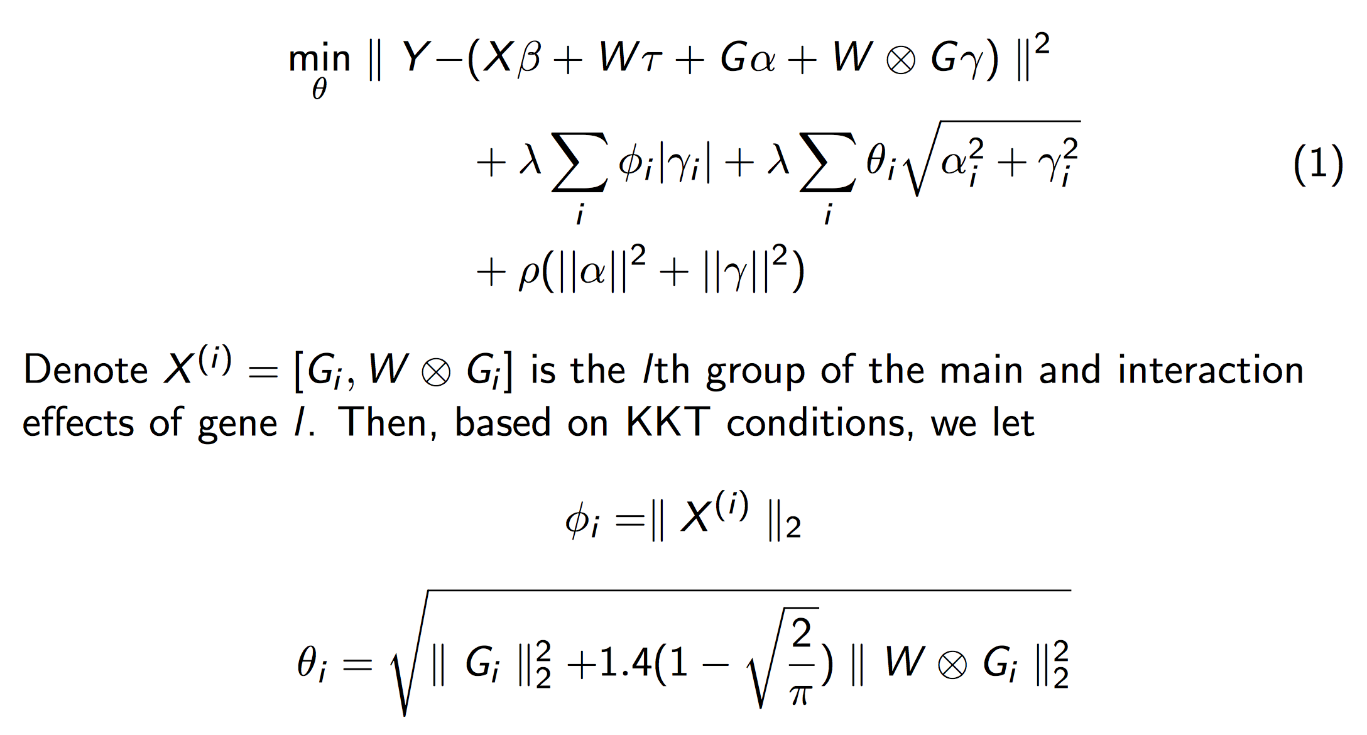
Adaptive Weights
Adaptive Weight

Slide 18
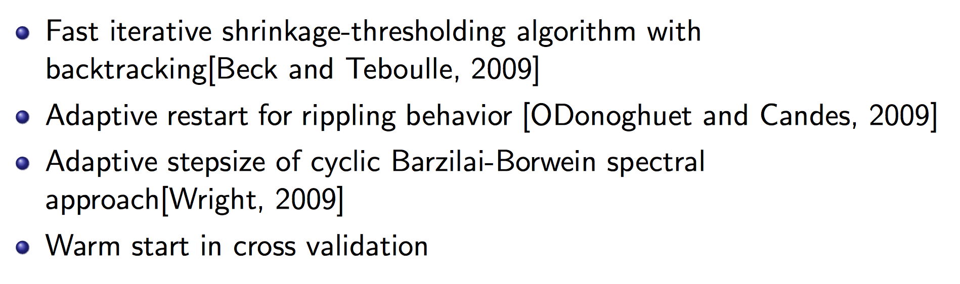
Optimization Strategies

Slide 19
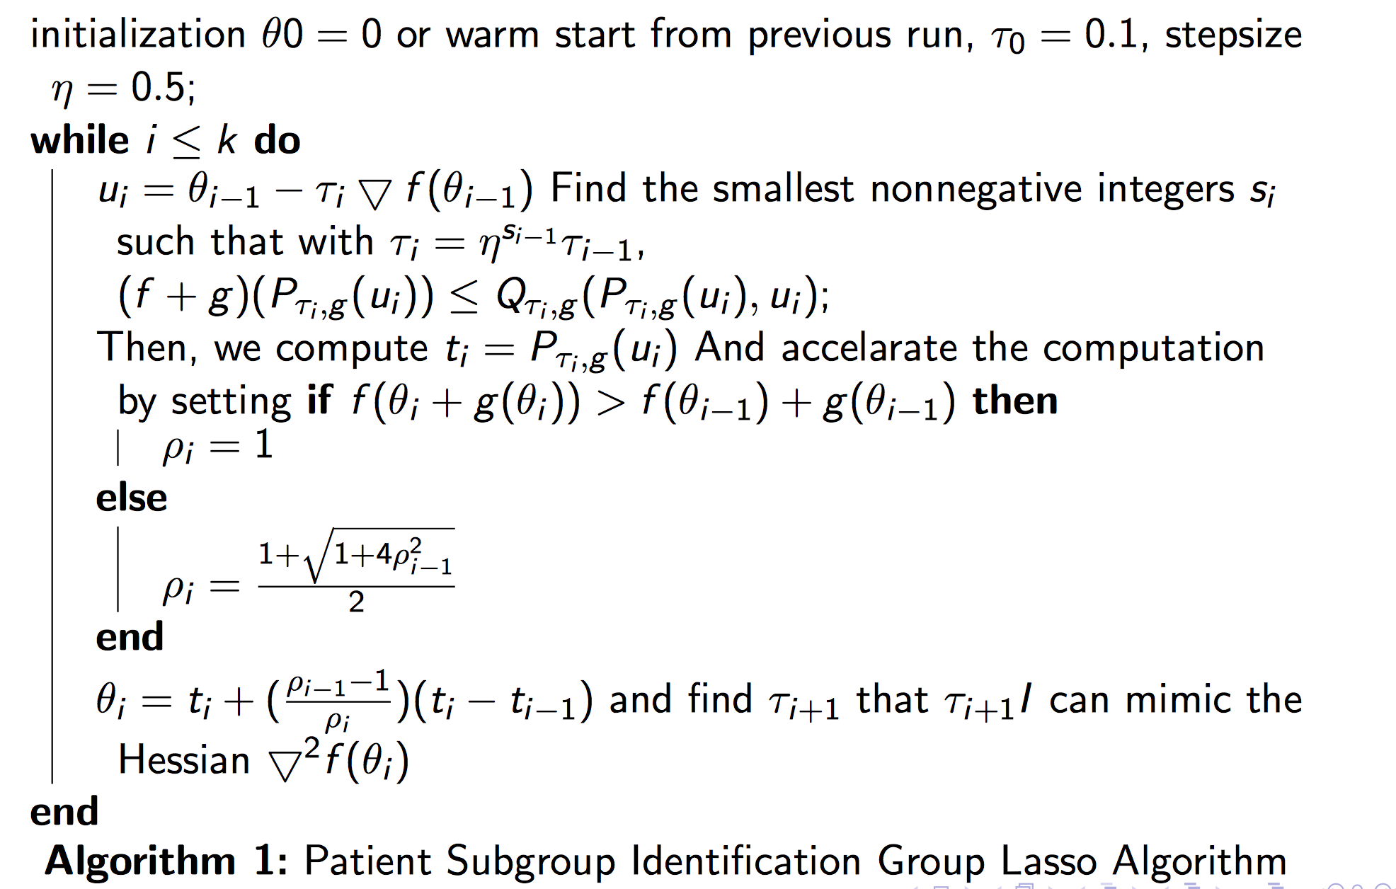
Algorithm

Slide 20
Simulations

Slide 21
Simulation Setup
N=100
Dimensions for baseline variables = 5 (Standard Normal Distribution)
Dimensions for treatment variable = 1, (binary: +1,-1)
Dimensions for Genes = 50, 100,200 (Standard Normal Distribution/Binomial Distribution)
Coefficients=+3,-3,+5,-5

Slide 22


5%, 10%, 15%, 20% of predictive effects are non-zero randomly
10%, 20%, 30%, 40% of prognostic effects are non-zero
Iterations: 100
Correlation: Block Autocorrelation Matrix with $p_{i,j}={0.3}^{\left|i−j\right|}$ inside blocks.
Prognostic Effects
40%
Predictive Effects
20%
$m$ biomarkers

Slide 23

Signal/Noise ratio (SNR)
For 100 genes: 1, 5, 10, 20, 100.
$SNR=\frac{var(y_{0})}{var(ε)}$, where $y=y_{0}+ε$

Slide 24
Other methods
General Elastic Net without penalizing baseline and treatment variables (Lasso)
Bayesian Model Averaging (BMA)
Stepwise Variable Selection by likelihood (step)
Iterative Sure Independent Screening (SIS)
Random Forest

Slide 25
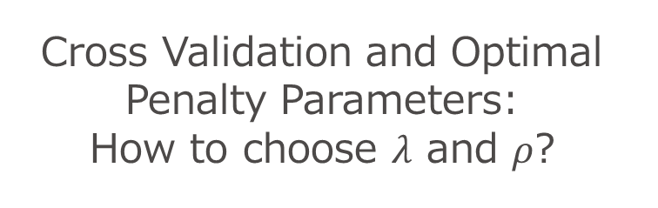
Cross Validation and Optimal Penalty Parameters: How to choose $λ$ and $ρ$?

Slide 26
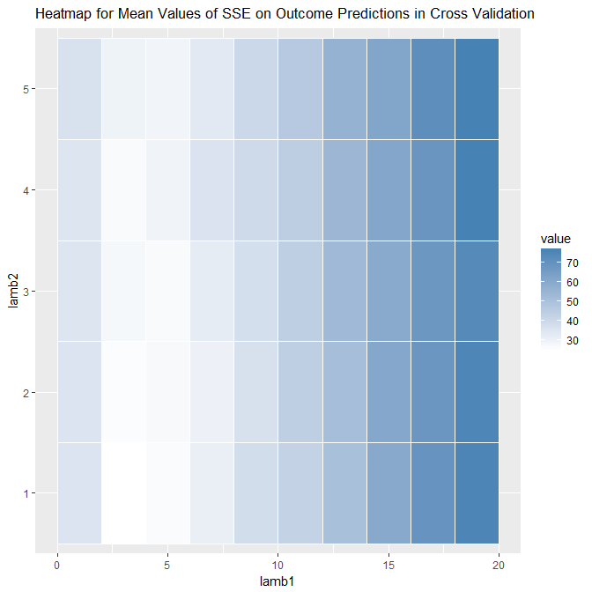
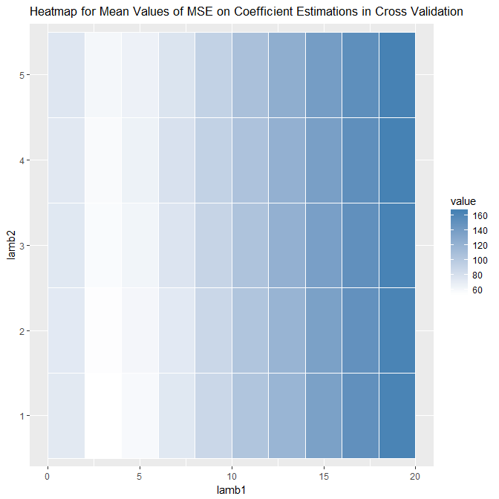
Distributions of MSE and SSE by Penalty Parameters
SSE
MSE

Slide 27
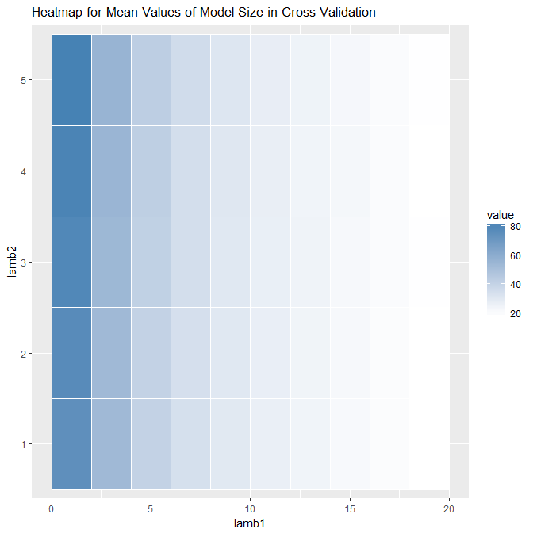
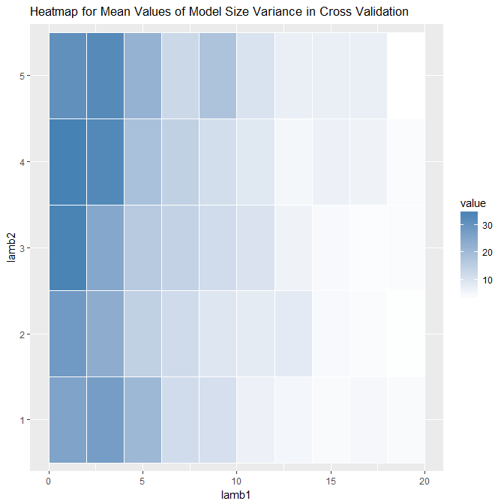
Selected Model Size
Mean of Model Size
Variance of Model Size

Slide 28
Optimal Regularization Parameters
Minimize AIC-like estimator may be a proper way for model selection, especially when we are more interested in predictive biomarkers.

Slide 29
Proportion of nonzero interactions

Slide 30
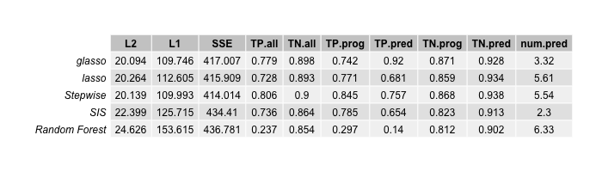
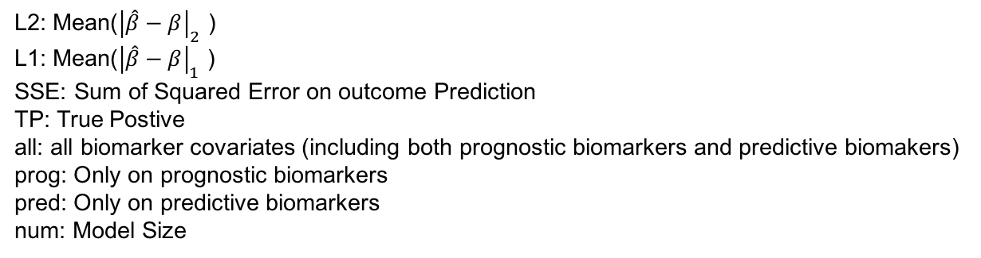
Nonzero Interaction Effects Proportion=5%
L2: Mean(${\left|\hat{β}−β\right|}_{2}$ )
L1: Mean(${\left|\hat{β}−β\right|}_{1}$ )
SSE: Sum of Squared Error on outcome Prediction
TP: True Postive
all: all biomarker covariates (including both prognostic biomarkers and predictive biomakers)
prog: Only on prognostic biomarkers
pred: Only on predictive biomarkers
num: Model Size

Slide 31
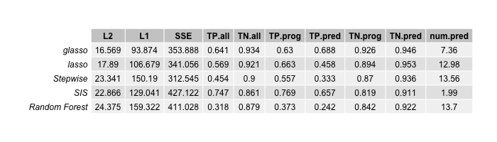
Nonzero Interaction Effects Proportion=10%
L2: Mean(${\left|\hat{β}−β\right|}_{2}$ )
L1: Mean(${\left|\hat{β}−β\right|}_{1}$ )
SSE: Sum of Squared Error on outcome Prediction
TP: True Postive
all: all biomarker covariates (including both prognostic biomarkers and predictive biomakers)
prog: Only on prognostic biomarkers
pred: Only on predictive biomarkers
num: Model Size

Slide 32
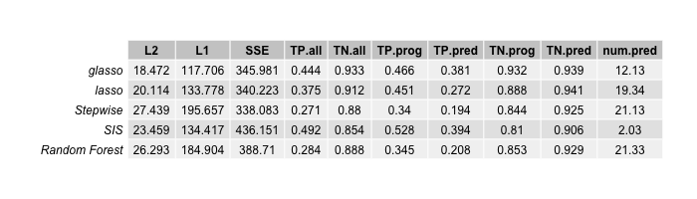
Nonzero Interaction Effects Proportion=0.15
L2: Mean(${\left|\hat{β}−β\right|}_{2}$ )
L1: Mean(${\left|\hat{β}−β\right|}_{1}$ )
SSE: Sum of Squared Error on outcome Prediction
TP: True Postive
all: all biomarker covariates (including both prognostic biomarkers and predictive biomakers)
prog: Only on prognostic biomarkers
pred: Only on predictive biomarkers
num: Model Size

Slide 33
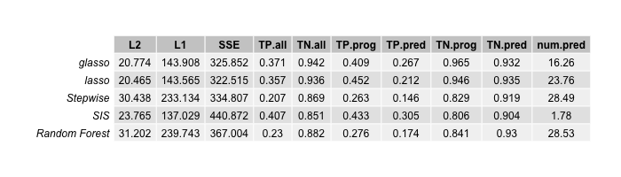
Nonzero Interaction Effects Proportion=0.2
L2: Mean(${\left|\hat{β}−β\right|}_{2}$ )
L1: Mean(${\left|\hat{β}−β\right|}_{1}$ )
SSE: Sum of Squared Error on outcome Prediction
TP: True Postive
all: all biomarker covariates (including both prognostic biomarkers and predictive biomakers)
prog: Only on prognostic biomarkers
pred: Only on predictive biomarkers
num: Model Size

Slide 34
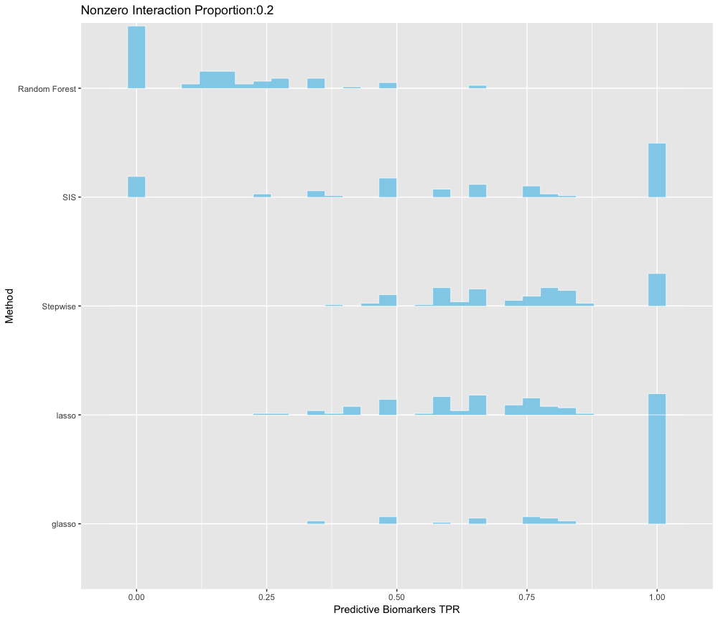
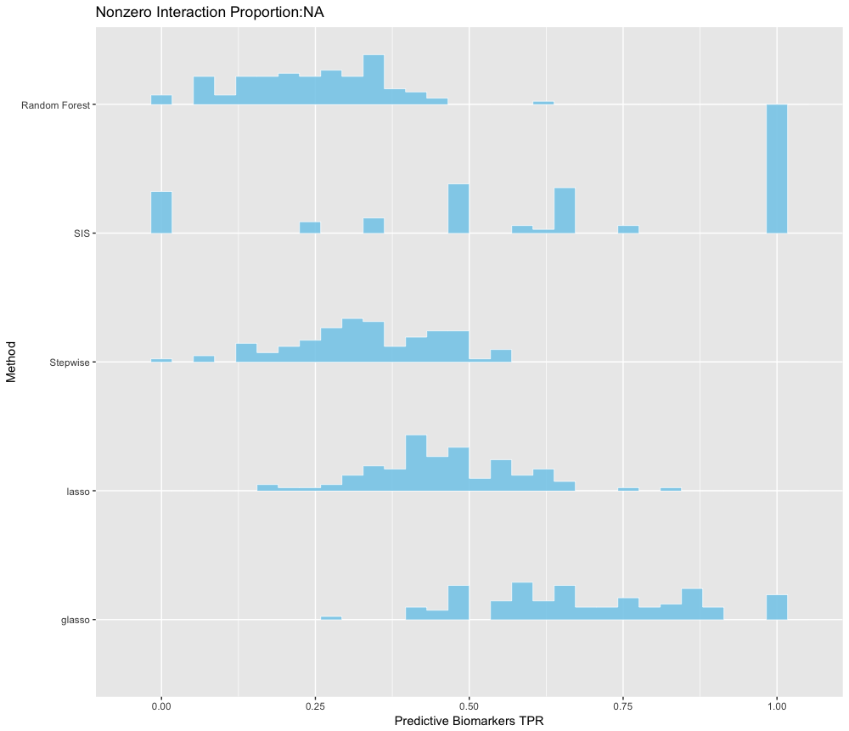
Distributions of TPR on Predictive Biomarkers Across All Simulations
Proportion=5%
Proportion=10%

Slide 35
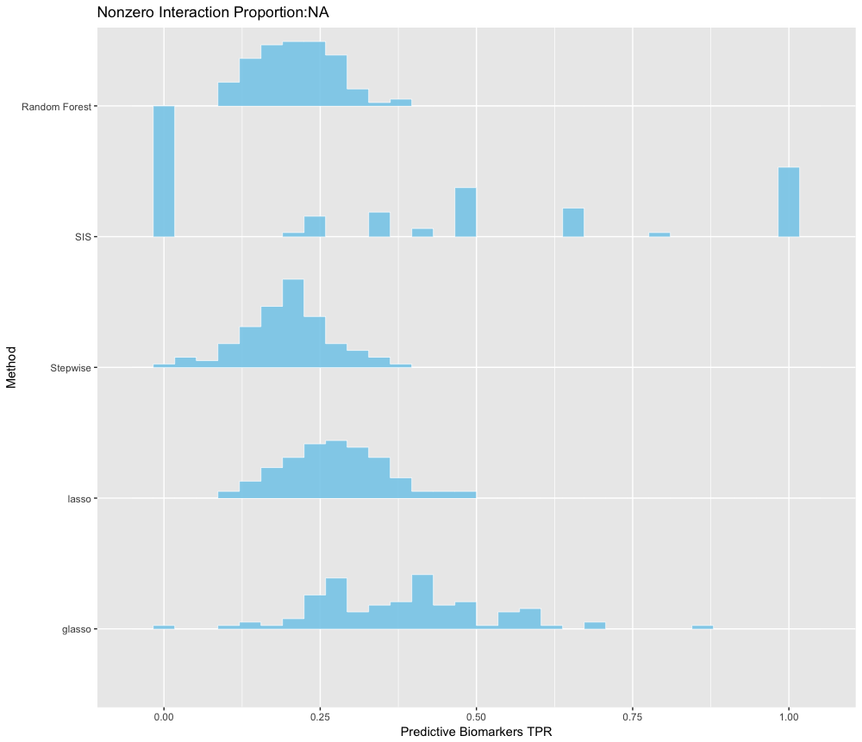
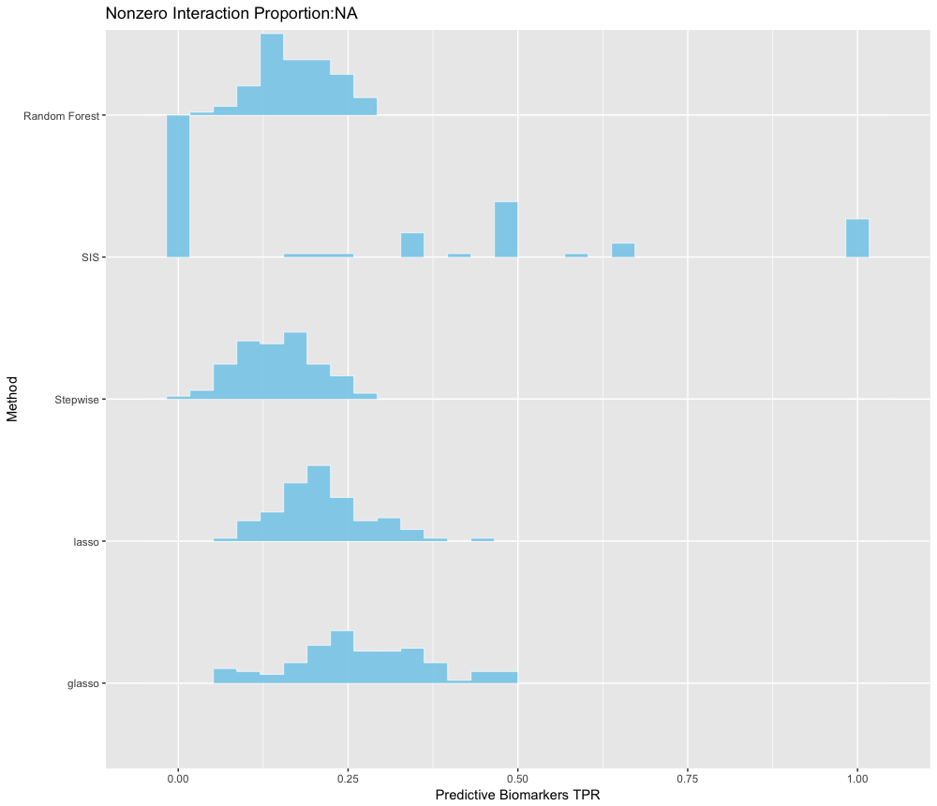
Distributions of TPR on Predictive Biomarkers Across All Simulations
Proportion=15%
Proportion=20%

Slide 36
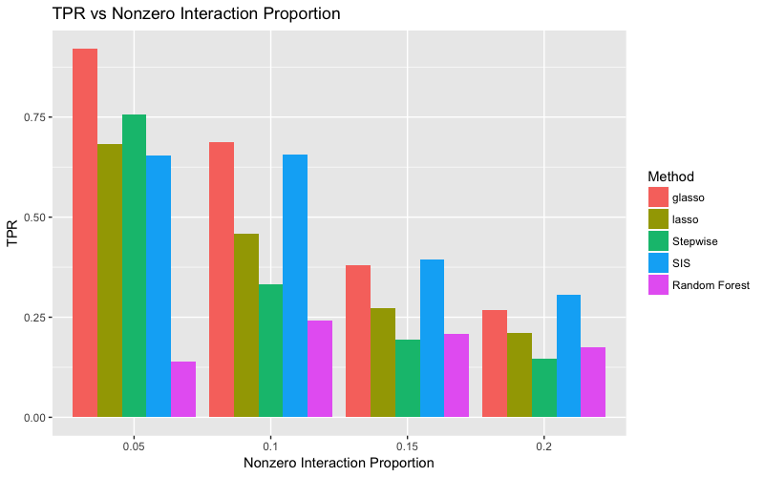

Slide 37
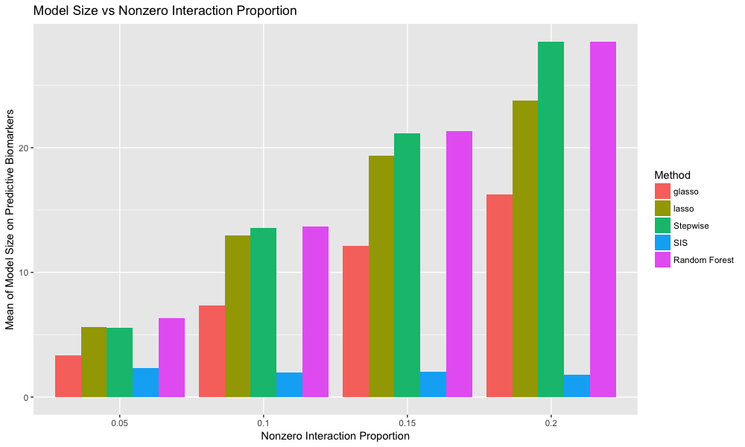

Slide 38
Signal Noise Ratio

Slide 39

SNR=1
L2: Mean(${\left|\hat{β}−β\right|}_{2}$ )
L1: Mean(${\left|\hat{β}−β\right|}_{1}$ )
SSE: Sum of Squared Error on outcome Prediction
TP: True Postive
all: all biomarker covariates (including both prognostic biomarkers and predictive biomakers)
prog: Only on prognostic biomarkers
pred: Only on predictive biomarkers
num: Model Size

Slide 40
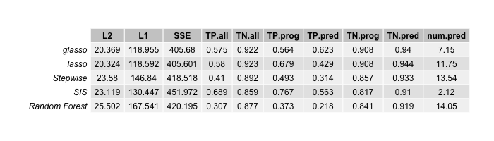
SNR=5
L2: Mean(${\left|\hat{β}−β\right|}_{2}$ )
L1: Mean(${\left|\hat{β}−β\right|}_{1}$ )
SSE: Sum of Squared Error on outcome Prediction
TP: True Postive
all: all biomarker covariates (including both prognostic biomarkers and predictive biomakers)
prog: Only on prognostic biomarkers
pred: Only on predictive biomarkers
num: Model Size

Slide 41
SNR=10
L2: Mean(${\left|\hat{β}−β\right|}_{2}$ )
L1: Mean(${\left|\hat{β}−β\right|}_{1}$ )
SSE: Sum of Squared Error on outcome Prediction
TP: True Postive
all: all biomarker covariates (including both prognostic biomarkers and predictive biomakers)
prog: Only on prognostic biomarkers
pred: Only on predictive biomarkers
num: Model Size

Slide 42

SNR=20
L2: Mean(${\left|\hat{β}−β\right|}_{2}$ )
L1: Mean(${\left|\hat{β}−β\right|}_{1}$ )
SSE: Sum of Squared Error on outcome Prediction
TP: True Postive
all: all biomarker covariates (including both prognostic biomarkers and predictive biomakers)
prog: Only on prognostic biomarkers
pred: Only on predictive biomarkers
num: Model Size

Slide 43
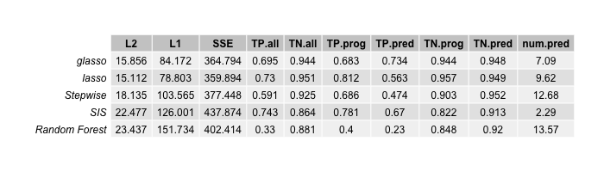
SNR=100
L2: Mean(${\left|\hat{β}−β\right|}_{2}$ )
L1: Mean(${\left|\hat{β}−β\right|}_{1}$ )
SSE: Sum of Squared Error on outcome Prediction
TP: True Postive
all: all biomarker covariates (including both prognostic biomarkers and predictive biomakers)
prog: Only on prognostic biomarkers
pred: Only on predictive biomarkers
num: Model Size

Slide 44
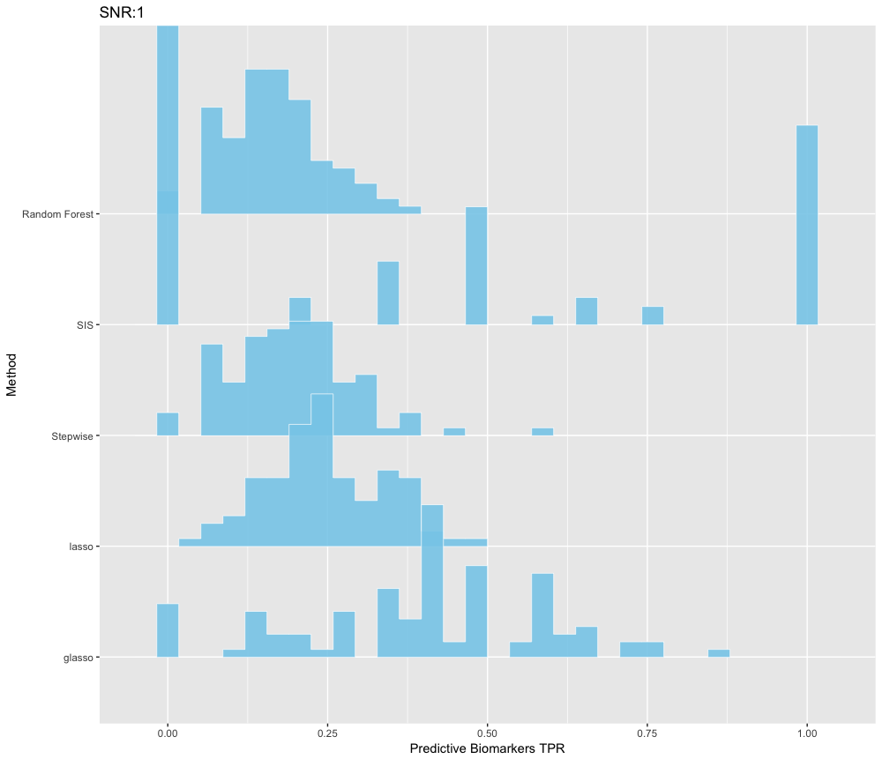
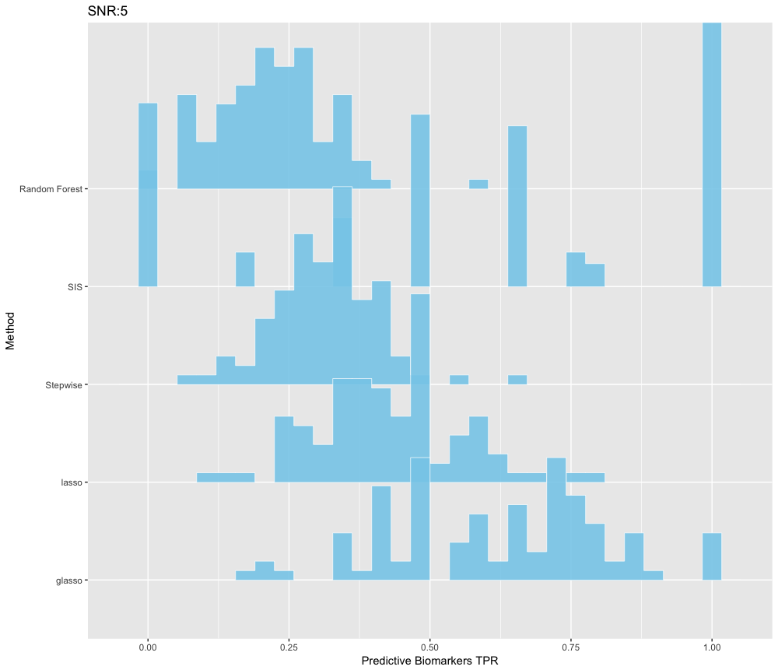
Distributions of TPR on Predictive Biomarkers Across All Simulations
SNR=1
SNR=5

Slide 45
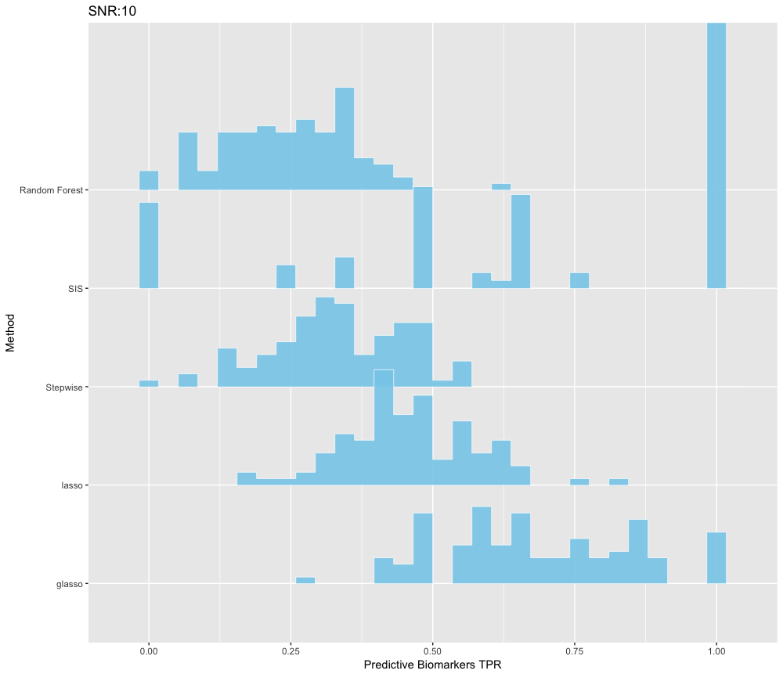
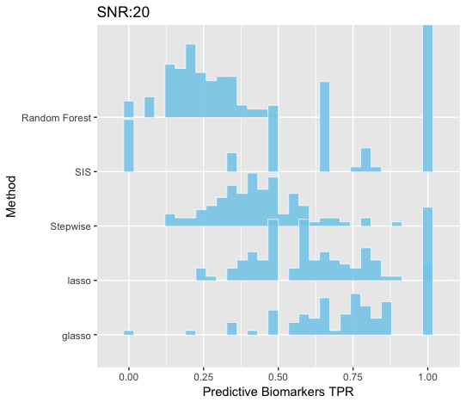
Distributions of TPR on Predictive Biomarkers Across All Simulations
SNR=10
SNR=20

Slide 46
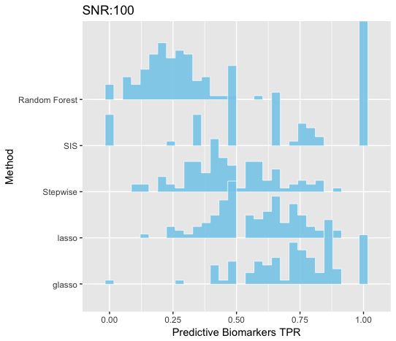
Distributions of TPR on Predictive Biomarkers Across All Simulations
SNR=100

Slide 47
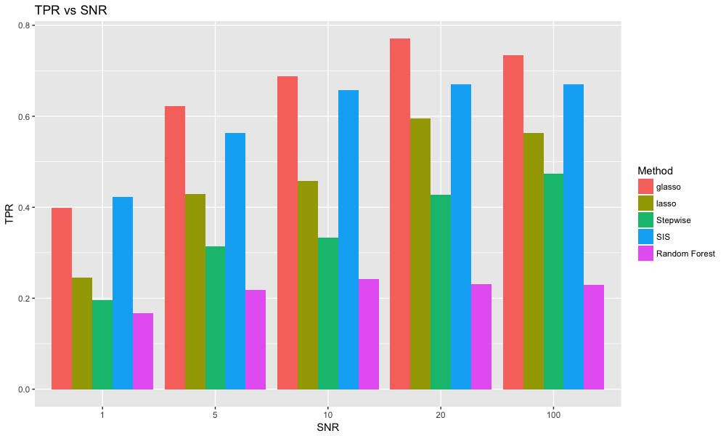

Slide 48
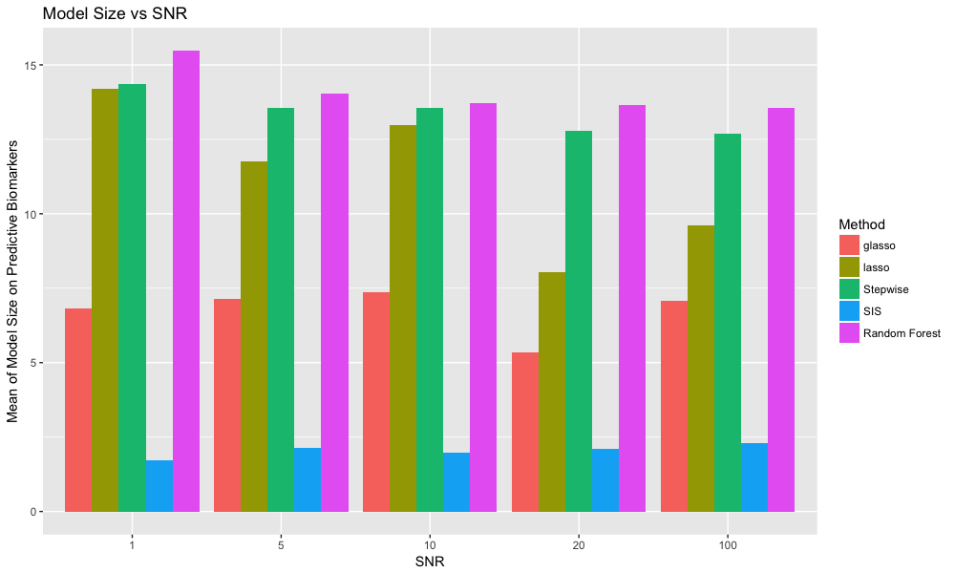

Slide 49
Other number of biomakers

Slide 50
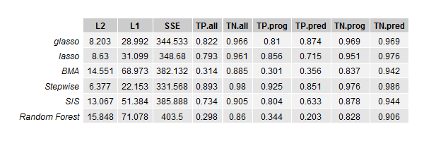
Dimension of genes=50 and total dimension=106

Slide 51
When number of biomarkers > sample size

Slide 52
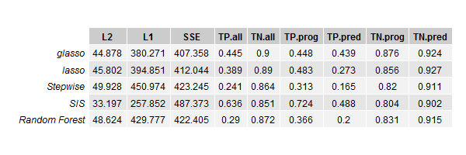
Dimension of genes=200 and total dimension=406

Slide 53
When covariates are SNP

Slide 54
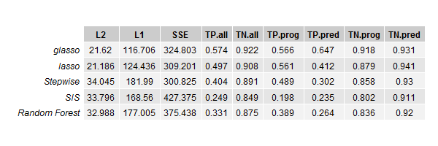
SNP

Slide 55
Real Data

Slide 56
Future Steps
Overlapping Simulations
Stop Criterion
Combination of Group Lasso with other methods
Endpoints

Slide 57
References

Slide 58
Thanks!

